Slide 1
Methods of Laser Frequency Stabilization
Dr. Wolfgang Korsch, Will Bodron, Charlotte Zehnder

Slide 2
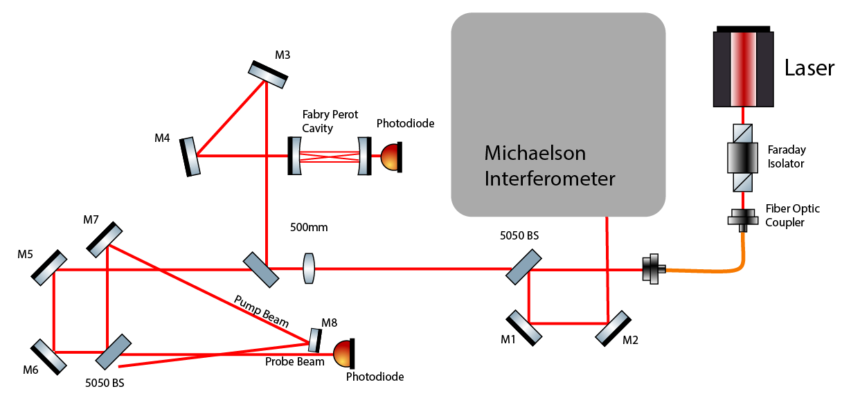
Experimental Setup
RB Cell
Notes:
Fiber Optic To be split. Need to minimize power requirements

Slide 3
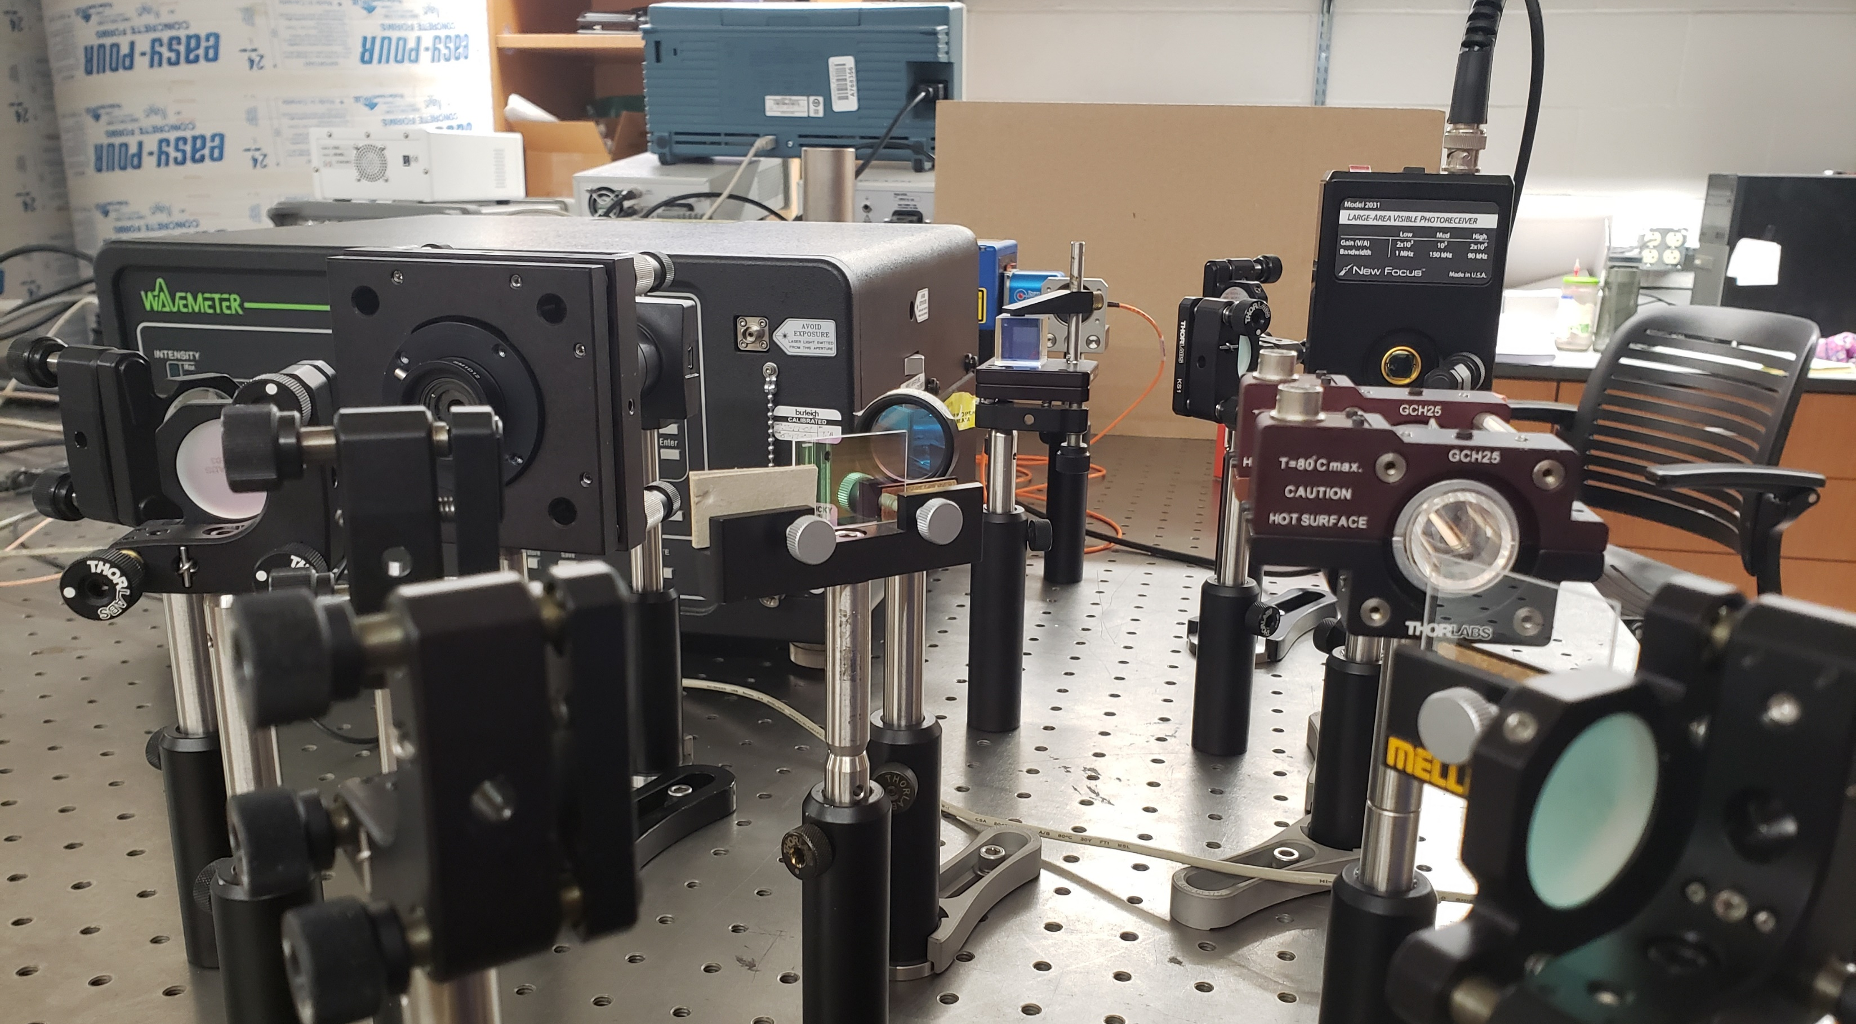

Slide 4
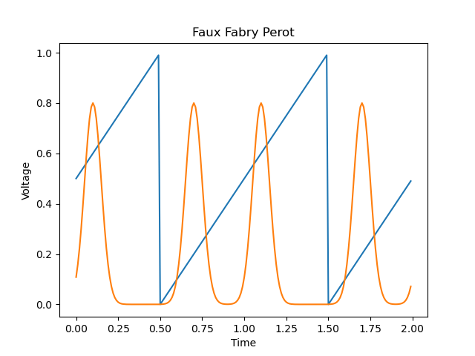
Scanning a Cavity or Transition
Axes Labels
X: analogous to wavelengths
Y: analogous to amount of light with that wavelength
Repetition is caused by the numerous wavelengths that constructively interfere in the Fabry-Perot Cavity
These peaks will slowly shift
Blue: Cavity Length
Orange: Transmission through Fabry Perot
Notes:
Easily set, but they don’t last more than about an hour

Slide 5
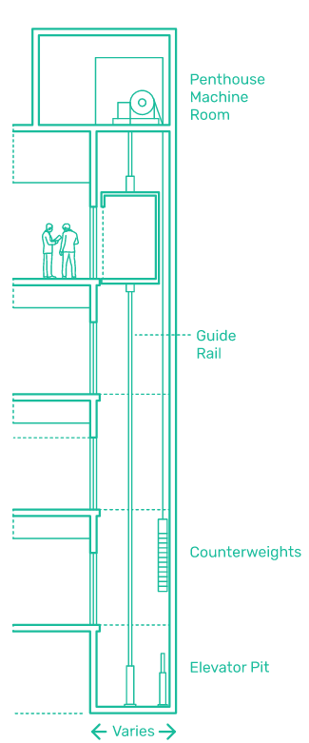
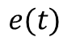
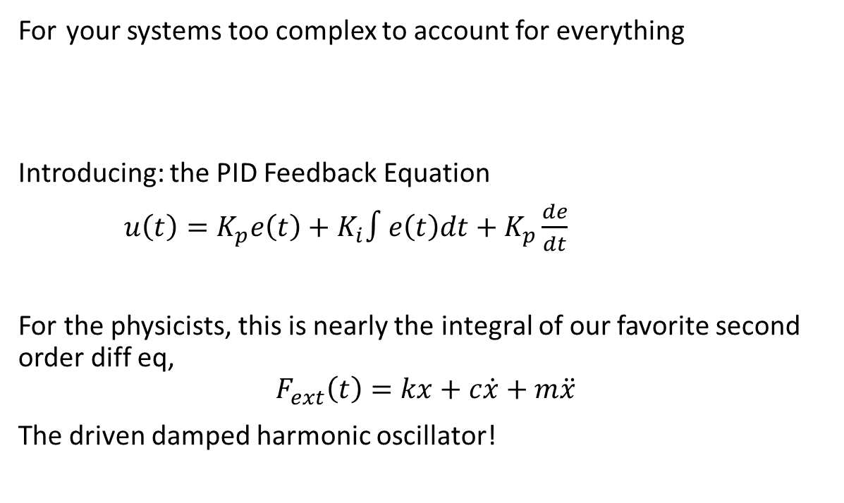
Methods to “Stabilize”: Elevator Pitch
For your systems too complex to account for everything
Introducing: the PID Feedback Equation
$u\left(t\right)=K_{p}e\left(t\right)+K_{i}∫e\left(t\right)dt+K_{p}\frac{de}{dt}$
For the physicists, this is nearly the integral of our favorite second order diff eq,
$$F_{ext}\left(t\right)=kx+c\dot{x}+m\ddot{x}$$
The driven damped harmonic oscillator!
$$e(t)$$
Notes:
Our $e(t)$ is given as a difference in the current slope and the starting slope we want to preserve, and $u(t)$ the small adjustment to the controls.

Slide 6
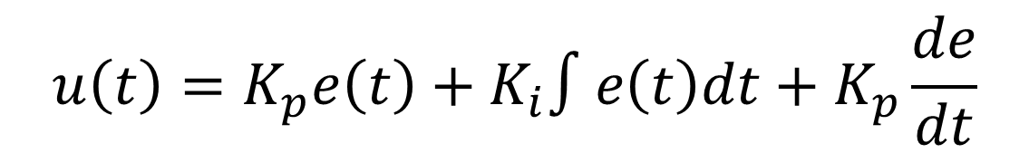
$$u\left(t\right)=K_{p}e\left(t\right)+K_{i}∫e\left(t\right)dt+K_{p}\frac{de}{dt}$$
$$e(t)$$
There are iterative methods to choose these coefficients. Many of them are manual, and that’s how we’ll be tuning our laser’s coefficients

Slide 7
How do we minimize the shift
Must be independent of incident intensity, as that will also fluctuate
Blue: Cavity Length
Orange: Transmission through Fabry Perot
Notes:
Easily set, but they don’t last more than about an hour

Slide 8
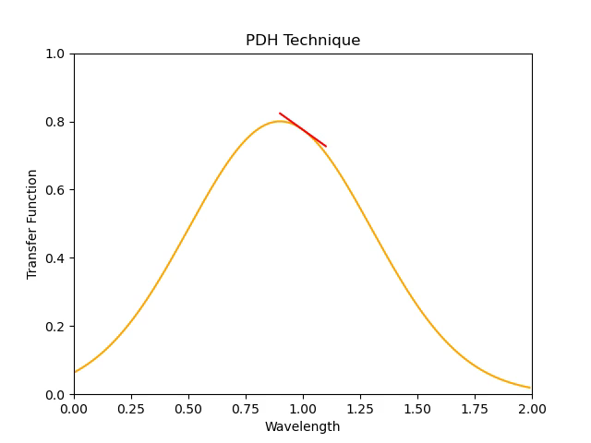
Pound-Denver-Hall Technique
Notes:
Talk about limitations

Slide 9
A look behind the code
e = 0; inte = 0; K_p = 0.01; K_i = 0.0002
wavelengths = [0.9]
for i in range(0,30): # iterations become frames in the animation
# Error is calculated as the slope evaluated at a set point (1)
e = slope(1, lambda x : bell(x, mu=wavelengths[i]))
# integral accumulates the error every cycle
inte += e
wavelengths.append(
wavelengths[i] # Simple addition to the previous wavelength is entirely unphysical.
+ # The real relationship between wavelength and applied voltage needs to
K_p*e # be understood only vaguely since it is changing.
+
K_i*inte
)
# I've left out the derivative because its especially useless in a noiseless environment

Slide 10
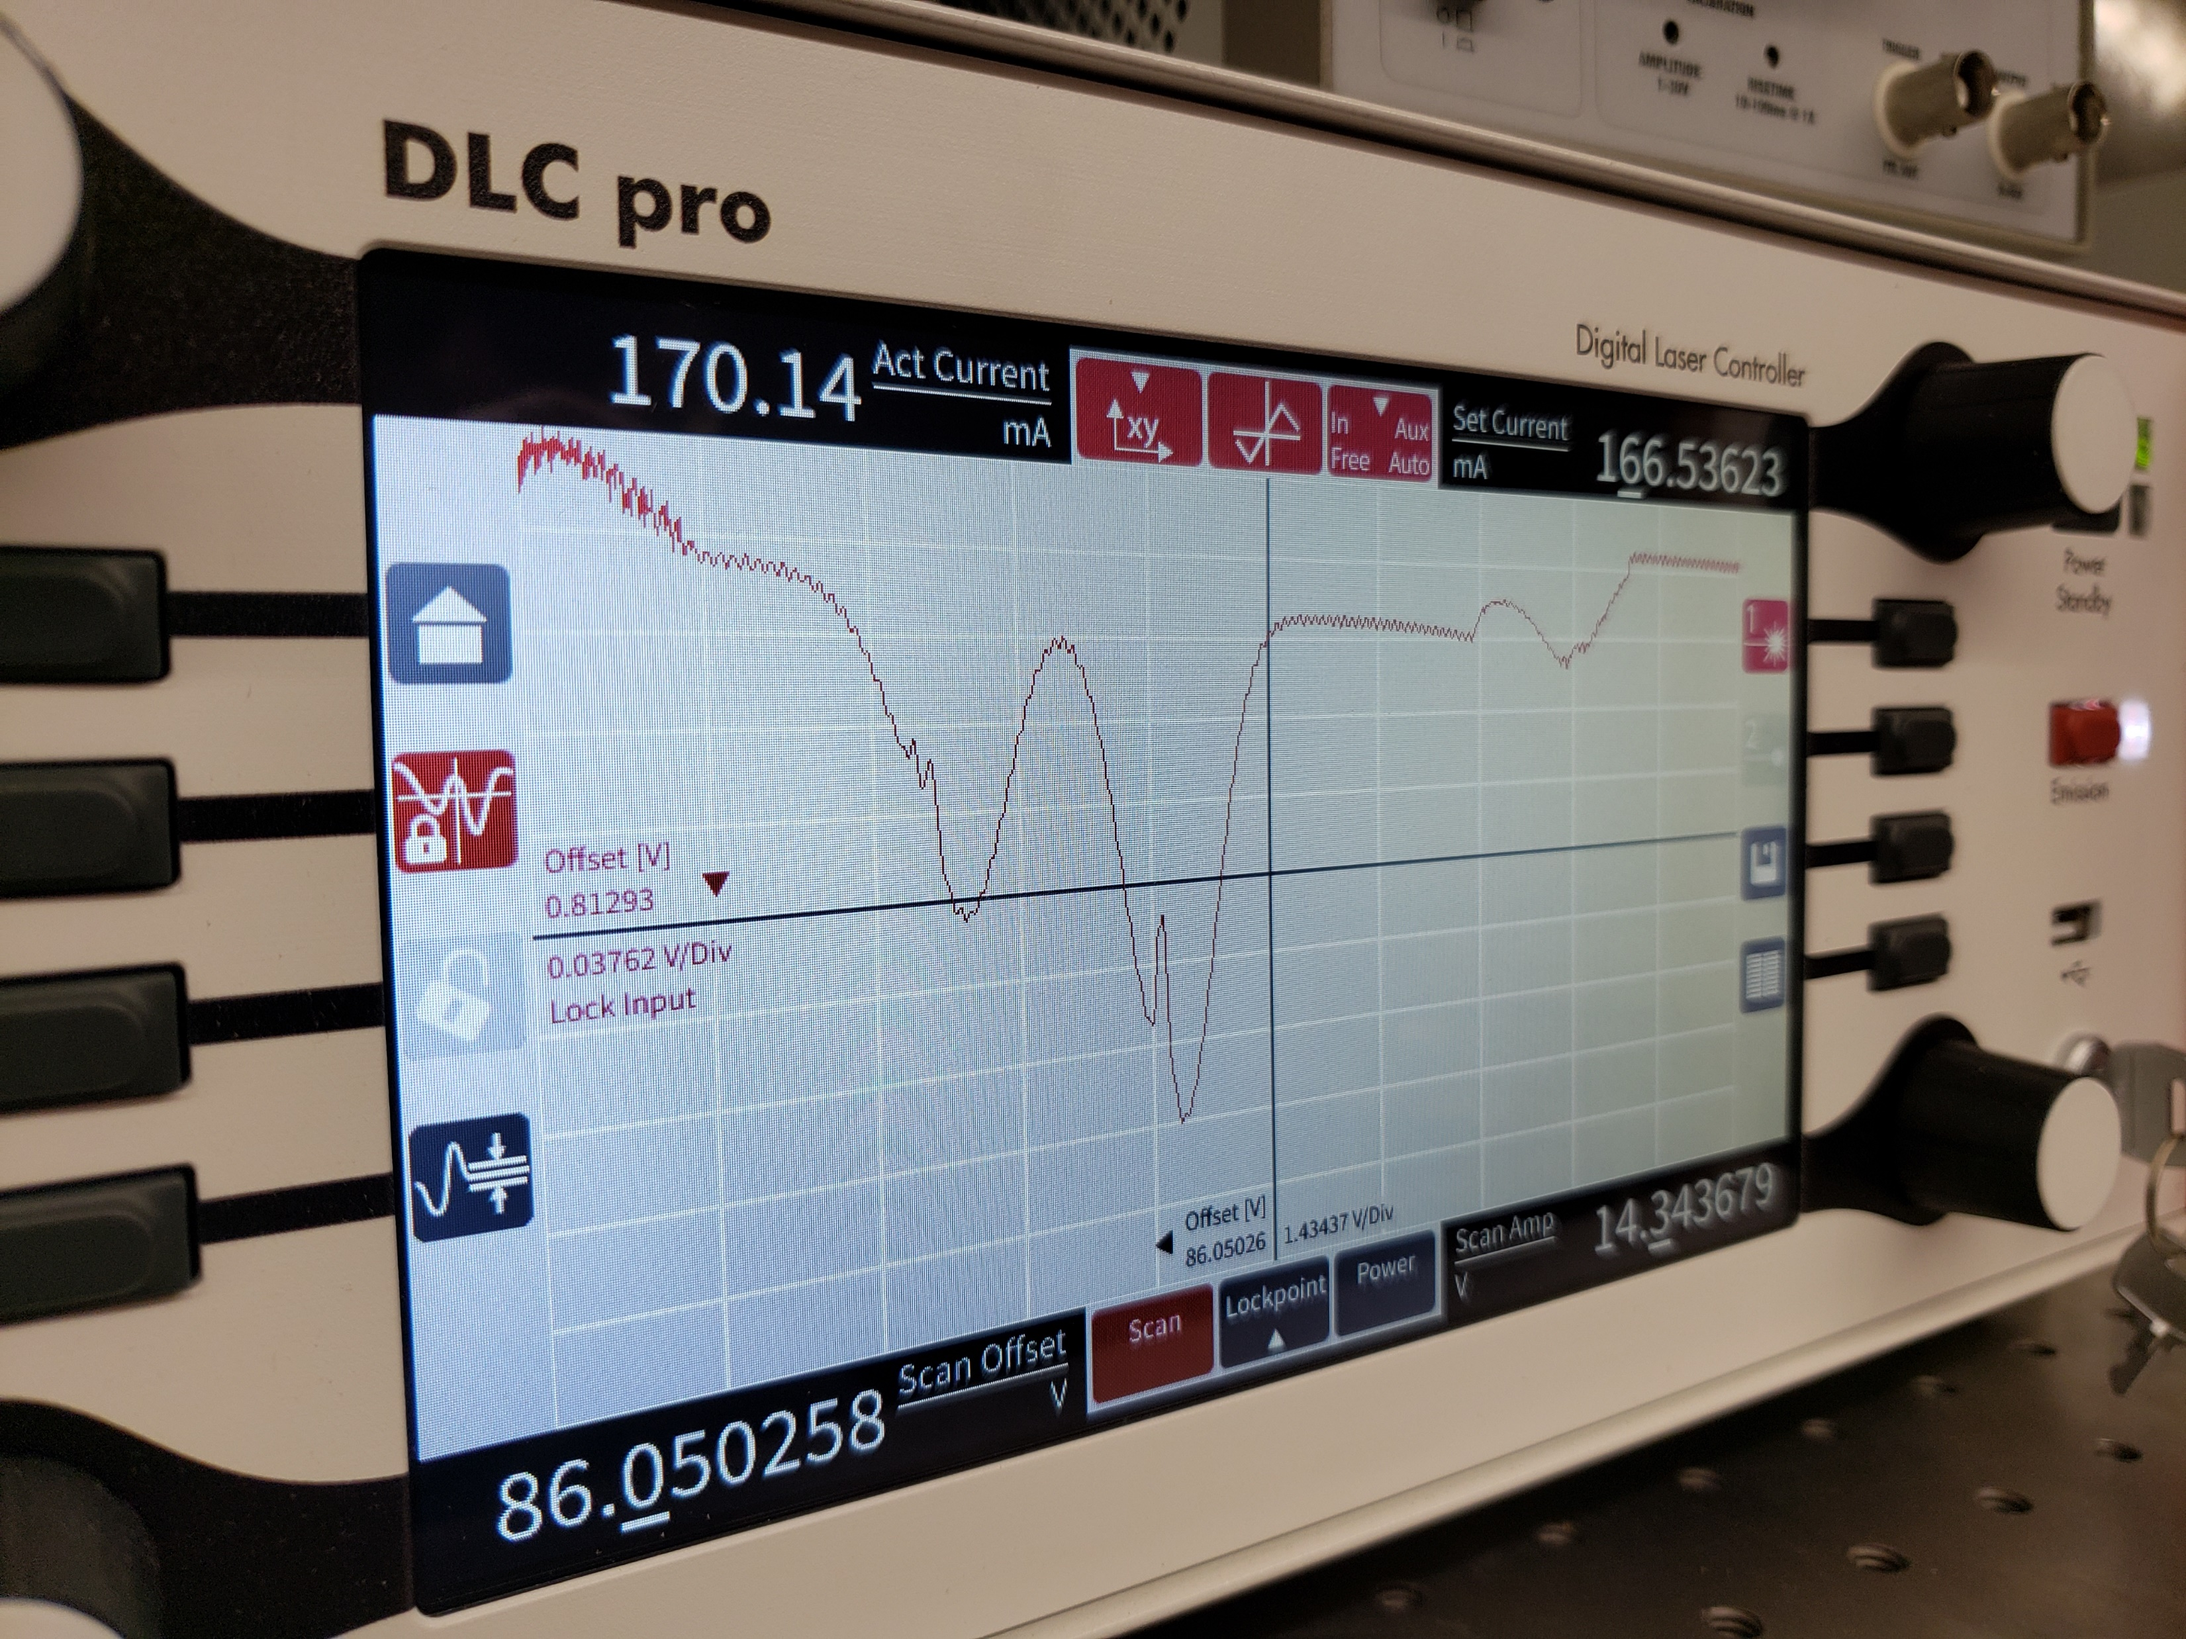
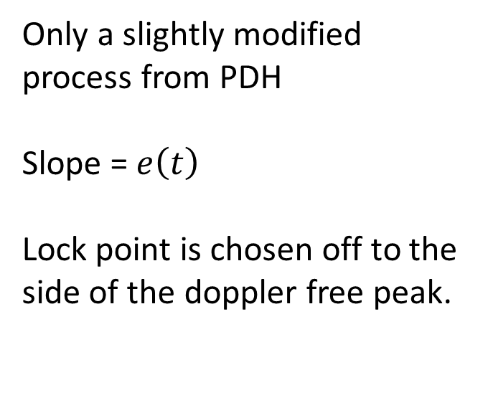
Locking to a Rb transition
Only a slightly modified process from PDH
Slope = $e\left(t\right)$
Lock point is chosen off to the side of the doppler free peak.

Slide 11
Resources
Wikipedia Contributors. “PID Controller.” Wikipedia, Wikimedia Foundation, 8 Mar. 2019, en.wikipedia.org/wiki/PID_controller.
“Introduction to Laser Frequency Stabilization.” Www.newport.com, www.newport.com/n/introduction-to-laser-frequency- stabilization. Accessed 7 July 2021.

